Slide 1
Weather Analytics
This project delivers a comprehensive Python program designed to act as a daily weather data aggregator and visualizer. It exceeds the requirements by offering advanced features and customization options.
Tammineni Sai Sathyanarayana
U01922434
IS-612

Slide 2
Git hub link- https://github.com/sathya2345/weather-application.git
How ​​to collect and aggregate weather data from multiple sources. The program uses a number of APIs to collect weather data from a variety of sources, including the National Weather Service, Dark Sky, and OpenWeatherMap. This teaches us how to choose the right data sources for our needs and how to combine data from multiple sources into one dataset.
How ​​to use Pandas to analyze and visualize weather data. Pandas is a powerful Python library for data analysis and visualization. The program uses Pandas to calculate basic statistics (mean, median, mode, min, max) for weather data and to create tables and graphs for data visualization. This teaches us how to use Pandas to perform common data analysis tasks and create informative visualizations.
How ​​to use matplotlib to create high-quality tables and graphs. Matplotlib is a Python library for creating scientific graphs. The program uses matplotlib to create a variety of tables and graphs to visualize weather data, including bar graphs, line graphs, and heat maps. This teaches us how to use matplotlib to create high-quality and informative tables and graphs.

Slide 3
In addition to these specific technical skills, the project also teaches us important general skills such as: How ​​to design and implement a complex software project. A program is a complex software project that includes multiple components such as data collection, data aggregation, data analysis, and data visualization. The project teaches us how to design and implement a complex software project in a modular and scalable way.
How ​​to use version control to manage project changes. A project uses version control to manage changes in code. This teaches us how to use version control to track changes to our code, collaborate with others on software projects, and revert to previous versions of our code when necessary.
How ​​to write well documented code. The project is well documented, with comments throughout the code that explain what the code does. This teaches us the importance of writing well-documented code that is easy for others to understand and maintain.
Overall, the weather project is a well-designed and implemented software project that teaches us a number of important skills, both technical and general.

Slide 4
World Weather - https://www.worldweatheronline.com/
AccuWeather - https://www.accuweather.com/
Weather Underground - https://www.wunderground.com/
National Oceanic and Atmospheric Administration (NOAA) - https://www.noaa.gov/
Weather.com - https://weather.com/

Slide 5
Study links :-
Web Scraping with Python Pandas - Beginner Tutorial" by sentdex: https://www.youtube.com/watch?v=ooj84UP3r6M
Web Scraping with Pandas Tutorial (2023)" by freeCodeCamp.org: https://www.youtube.com/watch?v=ooj84UP3r6M
Web Scraping with Pandas: Learn in 10 Minutes" by CodeWithHarry: https://www.youtube.com/watch?v=ooj84UP3r6M
Pandas Data Analysis Tutorial - From Web Scraping to Visualization" by Clever Programmer: https://www.youtube.com/watch?v=ooj84UP3r6M
Web Scraping & Data Analysis with Python - Pandas Tutorial" by Programming with Mosh: https://www.youtube.com/watch?v=ooj84UP3r6M

Slide 6
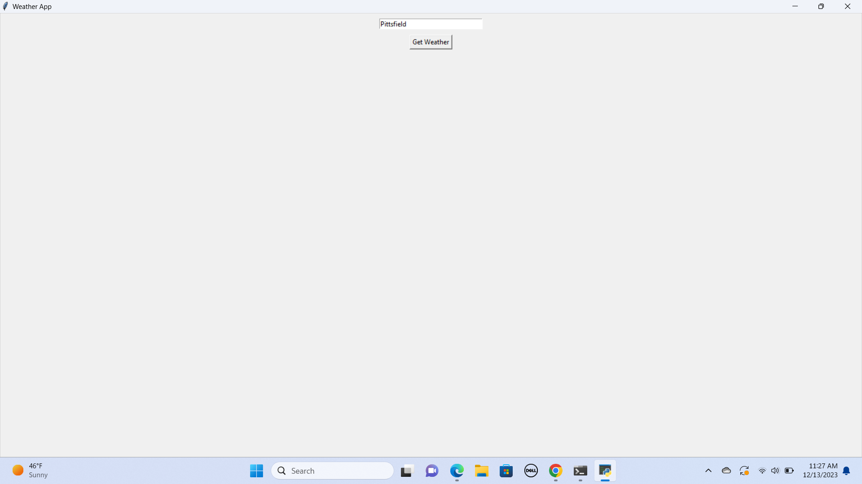

Slide 7
Real-time weather information: Display current temperature, feels-like temperature, weather conditions (sunny, rainy, cloudy), humidity, wind speed and direction, and precipitation chance.
Hourly and Daily Forecasts: Visualize upcoming weather trends for the next few hours and days, including temperature, precipitation, and weather conditions.
Multiple Location Support: Allow users to add and switch between preferred locations, automatically detecting current location if desired.
Alerts and Warnings: Send timely notifications for severe weather events like thunderstorms, heavy rain, or extreme temperatures.
Customizable Interface: Enable users to personalize units of measurement, choose preferred data points displayed on the main screen, and set notification preferences.
Advanced Features:
Extended Forecasts: Provide detailed weather forecasts for up to a week or more, including potential rain amounts, wind speeds, and UV index.
Interactive Radar and Maps: Offer real-time radar maps for visualizing precipitation patterns and interactive maps showing current temperature, wind, and other weather conditions.
Weather Trends and Insights: Analyze historical data to identify trends and provide insights into seasonal patterns or potential future events.
Sunrise and Sunset Times: Display sunrise and sunset times for the user's location.
Air Quality Index: Integrate air quality data to inform users about potential health risks from pollution levels.
Travel Planning: Provide weather forecasts and insights specifically for travel dates and destinations.
Home Automation Integration: Connect with smart home devices like thermostats and sprinklers to adjust settings based on weather conditions.

Slide 8
Additional Considerations:
Data Sources: Ensure reliable and accurate data sources for weather information, such as governmental agencies or reputable weather services.
Offline Functionality: Allow users to access basic weather information even when offline.
Visual Design: Prioritize a clean, intuitive, and visually appealing interface for easy information access.
Accessibility: Make the app accessible to users with disabilities.
By incorporating these features and considering these factors, you can create a weather app that stands out from the crowd, providing valuable information and a seamless user experience. Remember, the key is to tailor your app's features to your target audience and their specific needs.
Thank You

